Slide 1
LASER
&
IT’S APPLICATIONS
(CO-4 Part-I)
Dr. Prabodh Sahai Saxena
Prof & Head
Deptt of Physics
LNCT BHOPAL

Slide 2
Contents
Introduction of laser
Principle of laser
Einstein’s coefficients
Main components of laser
Importance of third energy level
Types of lasers

Slide 3
Introduction
The word laser is an acronym that stands for “light amplification by the stimulated emission of radiation”.
Lasers are essentially have following characteristics-
highly directional,
highly intense,
highly monochromatic &
highly coherent optical light source.

Slide 4
Laser based on the principle of stimulated emission.
Stimulated emission was postulated by Einstein as early as in 1917.
In 1960, a solid state Ruby laser is developed by Maiman on this principle.
In 1961, a gas state He-Ne laser is developed by Ali Javan and others in Bell telephone laboratory.

Slide 5
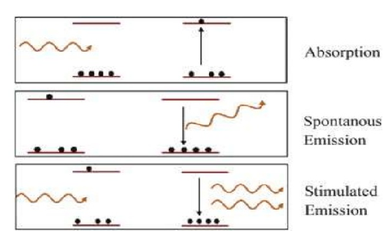
Principle of Laser

Slide 6
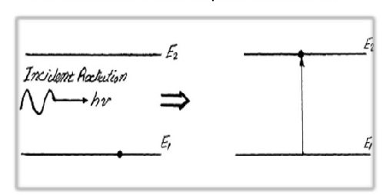
The process of exciting the atom from lower to higher energy level by absorbing the incident photon of light is known as absorption of radiation.
Absorption of Radiation

Slide 7
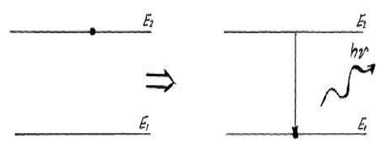
The transition of an excited atom by itself after rest time in excited state (10⁻⁸ sec) to lower energy level is known as spontaneous or self emission of radiation. The frequency of emitted photon is given by ν =E₂-E₁/h Where h=6.63˟10⁻³⁴ J sec=Plank’s constant
Spontaneous Emission of Radiation

Slide 8
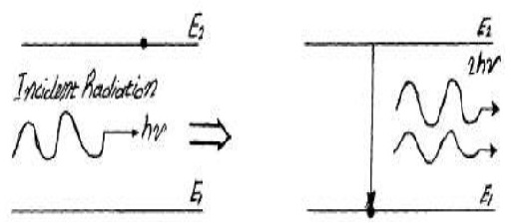
The excited atom after getting stimulated by the incident photon transits to lower energy level by emitting photons is known as stimulated emission of radiation.
Stimulated Emission of Radiation

Slide 9
Einstein’s coefficients
Einstein’s coefficients are of three types.
coefficient of Absorption (B₁₂):
P₁₂=B₁₂u(ν)
coefficient of Spontaneous emission (A₂₁):
P₂₁=A₂₁
coefficient of Stimulated emission (B₂₁):
P₂₁= B₂₁u(ν)
Where u(ν)=Energy density of the radiation

Slide 10
Relation between Einstein’s coefficients
If A₂₁ & B₂₁ are the coefficient of spontaneous & stimulated emission respectively, then
A₂₁/B₂₁ = 8πhν³/c³
Where c=3˟10⁸ m/sec=velocity of light
Which conclude that probability of spontaneous emission increase rapidly with energy difference( E₂-E₁=hν) between two states.

Slide 11
Terms related to Laser
Population Inversion:-This is the state in which larger number of atoms in the higher energy level than that the lower energy level.
N₂>>N₁
Pumping:- The process of achieving population inversion is known as pumping. Most commonly used methods are as follows.
Optical Pumping- (used in Ruby/NdYAG Laser)
Electric Discharge (used in He- Ne Laser)
Chemical reaction (used in CO₂ Laser)
Direct conversion (In semi conductor Laser)

Slide 12
Main components of Laser
Energy Source:- It is used to raise the system to an excited state.
Active Medium:- This is the material in which population inversion achieves. This may be solid, liquid or gas.
for example- In He-Ne Laser mixer of He-Ne gas, in Ruby laser ruby crystal, in NdYAG laser NdYAG crystal, in CO₂ laser CO₂ gas is active medium.
Optical Resonator :- It consists of two mirrors facing each other. The active medium is enclosed by this cavity. One of the mirror is fully reflecting while other mirror is partially transparent.

Slide 13
Importance of third energy level
With two energy levels rate of stimulated emission will equal to the rate of induced absorption. Therefore, condition of population inversion will not take place and laser amplification will not occur. So, third energy level is necessary for laser action. This is known as metastable state.
Metastable state:- It is a long lived energy state (10⁻³ sec) in which atom can stay longer time as compared to excited energy state. It is exist above the ground energy state. This is necessary to achieve population inversion.

Slide 14
Types of Lasers
Among the various kinds of lasers some important types of lasers are listed below:
Solid state laser : Ruby laser, NdYAG Laser
Gas laser : He-Ne laser, Co₂ laser
Liquid laser : Europium chelate laser
Dye laser : Courmarin dye laser
Semiconductor laser : Inp laser

