Slide 23
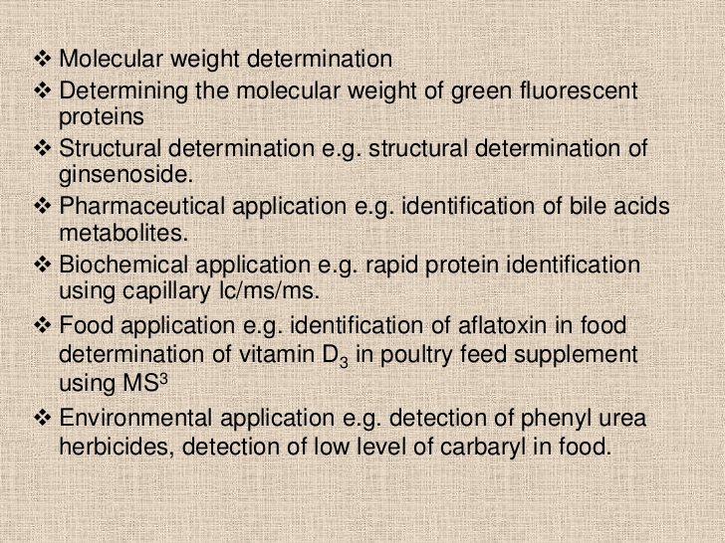

Slide 24
LC/MS plays a key role in the drug discovery and drug development process. Since the introduction of electrospray ionization a variety of LC/MS applications for the pharmaceutical industry have been developed for compound identification and quantification.
LC/MS is suitable for many applications, from pharmaceutical development to environmental analysis. Its ability to detect a wide range of compounds with great sensitivity and speci- ficity has made it popular in a variety of fields.
LCMS is always the method of choice when liquid chromatography is an essential step in an analytical procedure anyway, namely for the determination of highly polar, chemically or thermally labile compounds.

Slide 25
Biomedical Applications
The LC-MS technique is useful for the detection of steroid drugs in body fluids and in profiling endogenous steroids. Steroid sulfates have been detected with high sensitivity using this method. Plasmaspray has been used to test saliva for steroid hormones in patients suffering from congenital adrenal hyperplasia.
Amino acids were one of the first compounds analyzed using LC-MS coupled with laser desorption and thermospray. Nucleosides, nucleotides, saccharides, peptides, and proteins were all analyzed and their molecular weights were determined using LC-MS coupled with electrospray. Bile acids have also been determined using LC-MS and thermospray.
Environmental Applications
LC-MS is used in the analysis of diverse samples such as soil, drinking water or waste water, air, and sludge. The samples may belong to many different chemical species ranging from non-polar hydrocarbons to ionic organometallic species.
Several pesticides and herbicides including triazine derivatives, chlorophenols, phenoxyalkanoic acids, and sulfonylurea herbicides can be analyzed using LC-MS. Separation of polycyclic aromatic hydrocarbons and organometallic compounds is also possible using the technique.

Slide 26
Biochemical Screening for Genetic Disorders
Blood samples of newborn babies are analyzed using LC-MS to detect metabolic disorders.
Pharmaceuticals
LC-MS is widely used in the determination of pharmaceutical compounds and especially in the separation of optically active drugs. Antibiotics and potential antimalarials have been studied using thermospray. The use of LC-MS in the identification of bromazepam and similar drugs in case of intoxication has been successfully demonstrated.
Therapeutic Drug Monitoring and Toxicology
In drug monitoring, LC-MS assays have been developed for immunosuppressants including tacrolimus, cyclosporin, everolimus, sirolimus, and mycophenolic acid. Similar assays for aminoglycosides, anticancer drugs, and antiretrovirals have also been described.

Slide 27
Steroid Hormones
LC-MS analysis has been helpful in steroid biochemistry studies where traditional immunoassays have not proved very effective. Highly sensitive LC-MS assays have been developed for the measurement of low dihydrotestosterone and testosterone levels in women and children.
Vitamins and Related Metabolites
LC-MS is a preferred method for the measurement of vitamin D and its metabolites. LC-MS assays have been developed for 25-hydroxyvitamin D2 and D3 in plasma and serum. Similar assays are also available for fat-soluble vitamins such as vitamin K15 and Vitamin E13,15.

