Slide 1
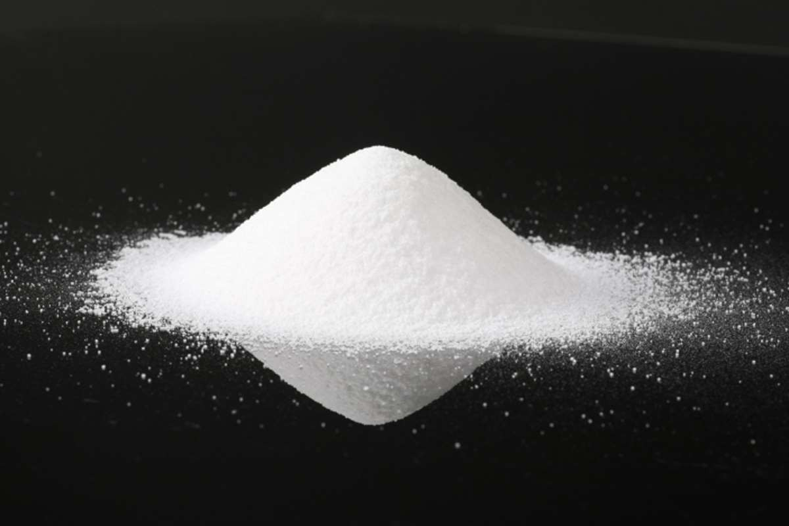

PRESENTED BY
RAMA SHUKLA
Assistant Professor
LNCP,Bhopal
1

Slide 2
Micromeritics & Powder Technology: Preformulation & formulation aspects
Syllabus
Basics of micromeritics- Fundamental and derived properties of powders and their measurement- particle shape & size, surface area, densities, flow properties, packing properties, fluidization of powders.
Large scale manufacturing aspects- Unit operations and equipment used: Size reduction, size separation, powder mixing, segregation of mixed powders; packaging & Q.C. of powders.
Brief coverage of following powders- Dusting po₂wders, Oral rehydration powders, Dry syrup formulations.

Slide 3
What is Micromeritics?
The Science and Technology of small particles is known as Micromeritics.
It is the study of various characteristics like
Particle size and size distribution
Particle shape and surface area
Porosity, Density, Flow property etc…
3

Slide 4
Need/ Importance/ Application of Micromeritics
Knowledge and control of the size and the size range of particle is of profound importance in pharmacy
Size and surface area can be related to the physical, chemical and pharmacological properties of a drug.
1. Drug release and dissolution: Particle size affects drug release from dosage forms that are administered orally, parenterally, rectally and topically. Higher surface area brings about intimate
4
contact of the drug with the dissolution fluids in

Slide 5
Need/ Importance/ Application of Micromeritics
Absorption and drug action: Particle size and surface area influence the drug absorption and subsequently the therapeutic action. Higher the dissolution faster the absorption. Hence quicker the drug action
Physical stability : Particle size influences the physical stability of suspensions and emulsions. Smaller the size better is the physical stability (as it would take more time for particles to agglomerate)
5

Slide 6
4. Dose uniformity: Particle size and shape also governs flow properties of powders and granules in tabletting.
 Any interference in the flowability of powders or granules may alter the weight of the powder blend and thus amount of drug incorporated into the tablet or capsules and thereby reduce the uniformity of the dose.
6

Slide 7
Examples…
Reduction of particles size improves surface area and can help in improving solubility of certain drugs. e.g. The solubility of Griseofulvin can be greatly increased by particle size reduction.
Reduction of particles size can increase the rate of absorption of and consequently bioavailability of many drugs e.g. tetracycline, aspirin and sulphonamides, nitrofurantoin etc..
7

Slide 8
Properties of Powders
Fundamental properties :-These properties relate to the individual particle.
Derived properties :- They are dependent on fundamental properties & define the factors relating to their measurement.
8

Slide 9
Fundamental properties:-
Particle size and size distribution
Particle shape
Particle surface area
Particle weight
Particle number
Derived properties:
Density of powders (a) bulk density (b)tapped density (c) granular density (d)true density
Flow properties of powders
Porosity
Bulkiness
9

Slide 10
Fu
ndamental properties of
powders
10

Slide 11
I. Particle size
Denoted in micrometers
(formerly called as microns)
One micrometer is equal to 10⁻³ mm or 10⁻⁶ m
One millimicrometer is called one nanometer (nm)
One nanometer = 10⁻⁹ m or 10⁻⁶ mm or 10⁻³ µm
1 m = 1000 mm
1 mm = 1000 µm
1 µm = 1000 nm
11

Slide 12
Particle size determination (PSD) -Methods
Optical Microscopy
Sieving Method
Sedimentation Method
Conductivity Method
12

Slide 13
1. Optical Microscopy
Particle size in the range of 0.2 – 100 µm can be measured.
This method gives number distribution which can be converted to weight distribution
Optical microscope lens has limited resolving power
Advanced microscopes have better resolving power and can measure size in nano range: Ultramicroscope, Electron microscope- Scanning Electron microscope (SEM), Transmission Electron microscope (TEM).
Application: Particle size analysis in suspensions, ae¹r³osols, globule size analysis in emulsion

Slide 14
Procedure:
Eye piece of the microscope is fitted with a micrometer.
This eye-piece micrometer is calibrated using a standard stage micrometer.
The powder sample is dispersed in a suitable vehicle in which it does not dissolve and its properties are not altered. (eg. water, paraffin oil.)
This sample is mounted on a slide and placed on the stage under the objective of microscope.
Around 625 particles are visualized. their d₁₄iameter is noted and mean is computed.

Slide 15
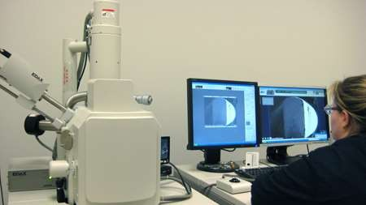
15

Slide 16
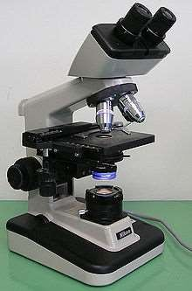
16

Slide 17
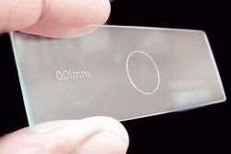
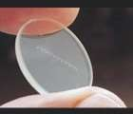
17

Slide 18
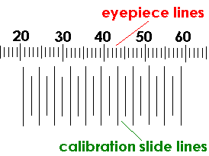
18

Slide 19
One can view particles
Any aggregates detected
Advantages
Contamination of particles detected
Use of cover slip for arresting motion of particles
Easy and simple
Disadvantages
  Length and breadth can be detected but depth or thickness of particles cannot be measured
  Slow- time consuming , tedious, inaccurate
  Number of particles to be measured is more
  ₁L₉ arge sample required

Slide 20
2. Sieving Method
Sieving method is an ordinary and simple method.
It is widely used as a method for the particle size analysis
Sieve analysis is usually carried out using dry powders. Although, for powders in liquid suspension or which agglomerate during dry sieving, a process of wet sieving can be used.
20

Slide 21
Sieving method directly gives weight distribution.
It find application in dosage form development of tablets and capsules.
Normally, 15% of fine powder should be present in granulated material to get proper flow of material and achieve good compaction.
Thus percent of coarse, moderate, fine powder is estimated by this method.
21

Slide 22
Sieve analysis utilizes a wire mesh made of brass, bronze or stainless steel with known aperture (hole) diameters which form a physical barrier to particles.
The standard sieve sizes are as per the pharmacopoeia
Method:
 Most sieve analyses utilize a series, stack (layer) of sieves which have the coarser mesh at the top of the series and smallest mesh at the bottom above a collector tray (The mesh size goes on decreasing from top
22
to bottom)

Slide 23

Method:
A sieve stack usually comprises 6-8 sieves.
Powder is loaded on to the coarsest sieve of the stack and then it is subjected to mechanical vibration for specified time, eg 20 minutes.
After this time, the powder retained on each sieve is weighed
The particles are considered to be retained on the sieve mesh with an aperture corresponding to the sieve diameter.
The size is estimated as per the standards given in pharmacopoeia
23

Slide 24
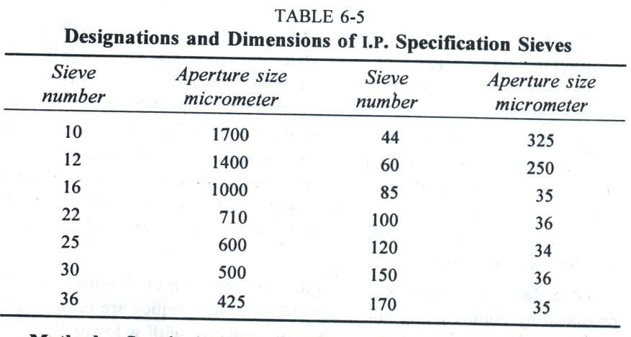
24

Slide 25
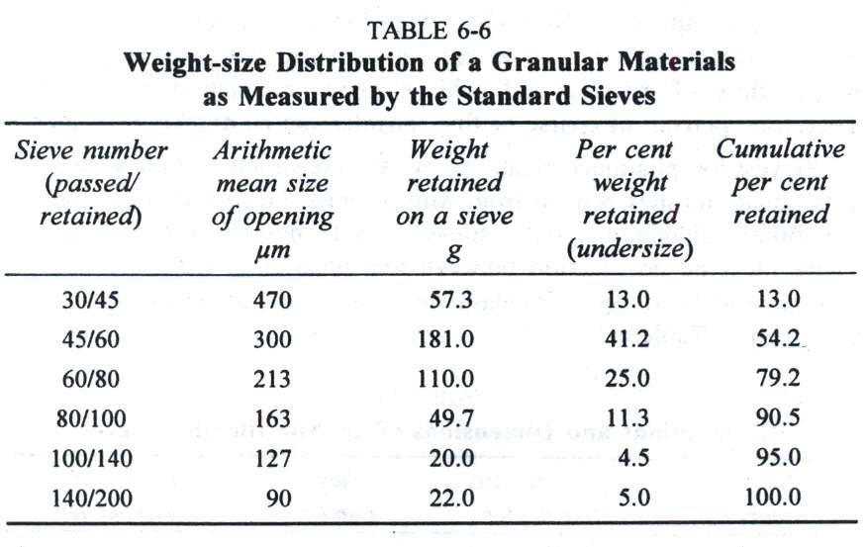
25

Slide 26
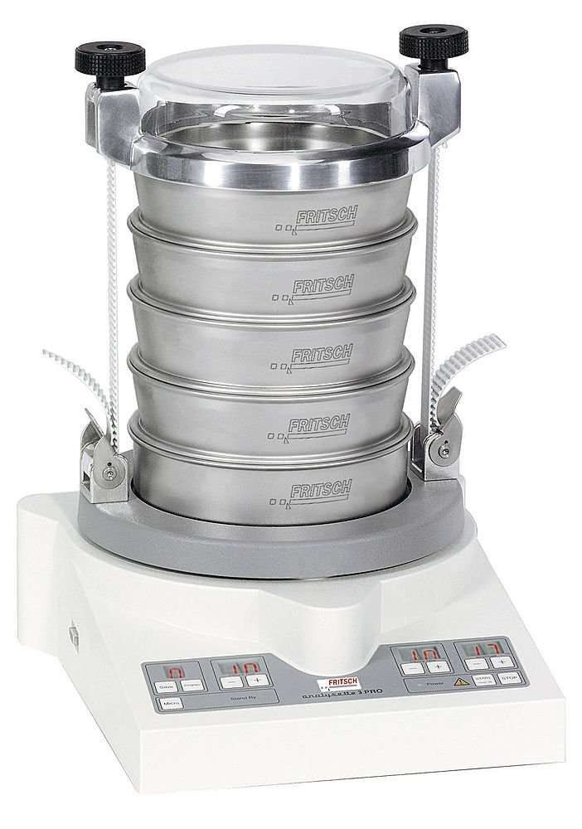
26

Slide 27
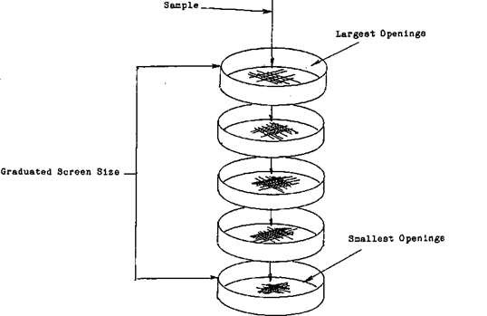
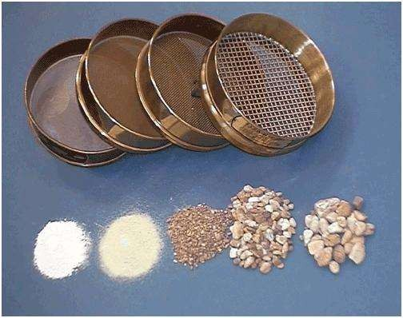
27

Slide 28
Care should be taken to get reproducible results.
The type of motion, time of operation, speed, weight of powder should be fixed and standardized.
Advantages- Inexpensive, Simple, Rapid, Reproducible results (if parameters are standardized)
Disadvantages- lower limit is 50 microns
Powder if moist, can cause clogging of apertures
Attrition between particles during the process may ca₂u₈ se size reduction giving inaccurate results.

Slide 29
3. Sedimentation Method
In this method particle size can be determined by examining the powder as it sediments out.
Sample preparation: Powder is dispersed in a suitable solvent
If the powder is hydrophobic, it may be necessary to add dispersing agent to aid wetting of the powder.
In case where the powder is soluble in water it will be necessary to use non- aqueous liquids or carry out the analysis in a gas.
29

Slide 30
Principle of Measurement
Particle size analysis by sedimentation method can be divided into two main categories according to the method of measurement used.
One of the type is based on measurement of particle in a retention zone.
Another type uses a non-retention measurement zone.
An example of a non-retention zone measurement is known as the pipette method.
30

Slide 31
 One of the most popular of the pipette methods was that developed by Andreasen and Lundberg and commonly called the Andreasen pipette.
Andreasen pipette method:
In this method , known volumes of suspension are drawn off and the concentration differences are measured with respect to time.
It involves measuring the % of solids that settle with time in a graduated vessel.
31

Slide 32
Construction:
The Andreasen fixed-position pipette consists of a 200 mm graduated cylinder which can hold about 500 ml of suspension fluid.
A pipette is located centrally in the cylinder and is held in position by a ground glass stopper so that its tip coincides with the zero level.
A three way tap allows fluid to be drawn into a 10 ml reservoir which can then be e₃₂mptied into a beaker or centrifuge tube.

Slide 33
Method:
A 1% suspension of the powder in a suitable liquid medium is placed in the pipette.
At a given intervals of time, samples are withdrawn from a specified depth without disturbing the suspension.
The amount of powder can be determined by weight following drying or centrifuging; alternatively, chemical analysis of the particles can be carried out.
33

Slide 34

 The particle size is determined in terms of stokes’ diameter (the diameter of a particle measured during sedimentation at constant rate) using modified Stokes' equation.
dst: stokes’ diameter
n: viscosity of medium
h: sedimentation height
ps- pf: difference in density of particle and fluid
Fg: force of gravity
t: sedimentation time
34

Slide 35
A pipette is located centrally in the cylinder and is held in position by a ground glass stopper so that its tip coincides with the zero level.
A three way tap allows fluid to be drawn into a 10 ml reservoir which can then be emptied into a beaker or centrifuge tube.
The amount of powder can be determined by weight following drying or centrifuging.
The data of cumulative weight is used for the determination of particle weight distribution, n35umber distribution etc..

Slide 36
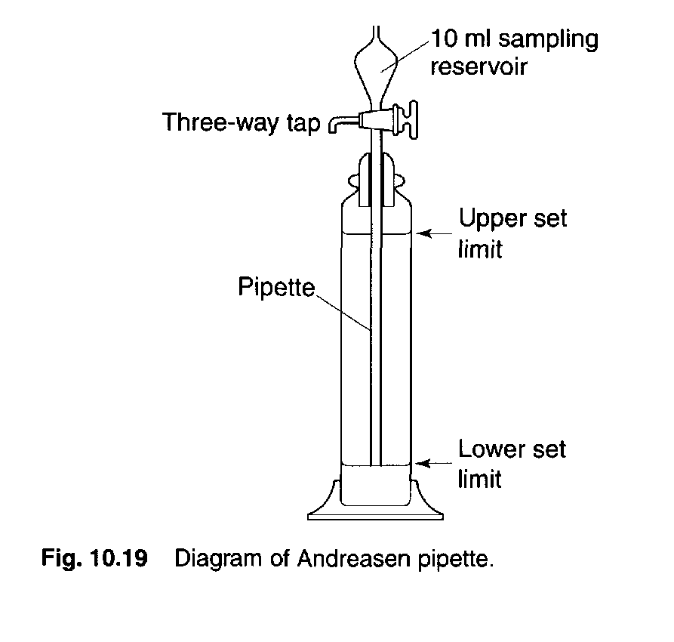
36

Slide 37
 The second type of sedimentation size analysis, using retention zone methods, also uses Stokes' law to quantify particle size.
One of the most common retention zone methods uses a sedimentation balance.
In this method the amount of sedimented particles falling on to a balance pan suspended in the fluid is recorded.
37
The continual increase in weight of

Slide 38
4. Conductivity methods
There are various subtypes. Two popular methods are-
Electrical stream sensing zone method (Coulter counter)
Laser light scattering methods
It is based on the principle of change in light intensity. The measurement of this change in light intensity gives estimate of particle size.
38

Slide 39
Electrical stream sensing zone method(Coulter counter)
Sample Preparation:
Powder samples are dispersed in an electrolyte to form a very dilute suspension.
The suspension is usually subjected to ultrasonic agitation to break up any particle agglomerates.
A dispersant may also be added to aid particle deagglomeration.
39

Slide 40
Electrical stream sensing zone method(Coulter counter)
Method
The particle suspension is drawn through an aperture accurately drilled through a sapphire crystal set into the wall of a hollow glass tube.
Electrodes, situated on either side of the aperture are surrounded by an electrolyte solution.
These electrodes monitor the change in electrical signal which occurs when a particle momentarily occupies the orifice and displaces its⁴⁰own volume of electrolyte.

Slide 41
Electrical stream sensing zone method(Coulter counter)
Method
 The volume of electrolyte fluid which is displaced in the orifice by the presence of a particle causes a change in electrical resistance between the electrodes which is proportional to the volume of the particle.
41

Slide 42
Advantage:
Particle size ranging from 0.5 – 500 microns
Gives number distribution, Particle volume measured and can be converted to diameter.
Accurate, sensitive, fast technique.
4000 particles per second can be counted.
Disadvantage
Expensive
42

Slide 43
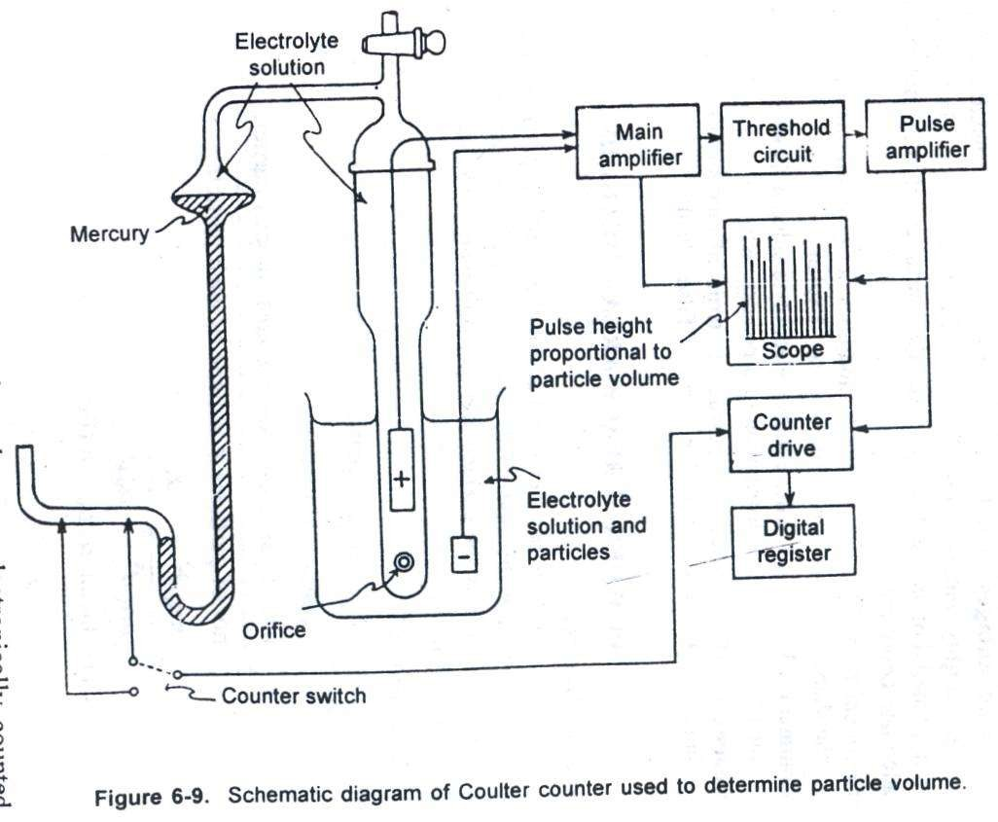
43

Slide 44
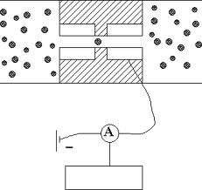
44

Slide 45
II. Particle Shape Determination
Particle shape also has influence on surface area, flow properties, packing and compaction of the particles.
Spherical particles have minimum surface area and better flow properties.
Shape can also have influence on rate of dissolution of drugs.
Techniques of determination are:
Microscopy (refer in particle size determination)
Light scattering
45

Slide 46
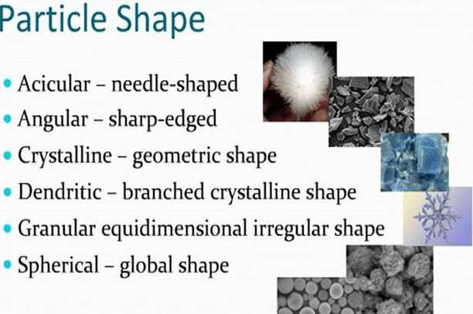
46

Slide 47
III. Surface Area Determination
1. Adsorption method:
Surface area is most commonly determined based on
Brunauer-Emmett-Teller (BET) theory of adsorption.
Most substances adsorb a monomolecular layer of gas under certain conditions of partial pressure of gas and temperature.
The adsorption process is carried out at liquid nitrogen temperatures -196˚C.
Once surface adsorption has reached equilibrium, the sample is heated at RT and Nitrogen gas is desorbed. Its volume is measured.
As each N₂ mol. occupies fixed area, one can compute
surface area of pre-weighed sample.
47

Slide 48
Surface Area Determination
2. Air Permeability method:
Powder is packed in sample holder
Packing appears as series of capillaries
Air is allowed to pass through the capillaries at constant pressure
Resistance is created as air passes through capillaries thus causing pressure drop.
Greater the surface area greater the resistance
Air permeability is inversely proportional to the surface area
48

Slide 49
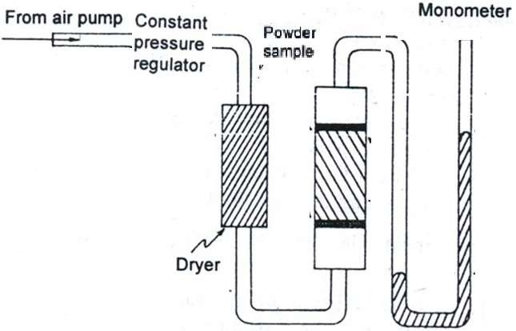
Manometer
49

Slide 50
Surface area of a powder can be calculated using
particle size data obtained from any suitable method.
Specific surface area i.e. surface area per unit weight (S_{w}) or unit volume (S_{v}) can be estimated as follows:
S_{v} = surface area of particles
volume of particles
S_{v} = no. of particles x surface area of each particle no. of particles x volume of each particle
Surface area is an important parameter as the bioavailability of certain drugs is dependant on surface area. eg. Bephenium (anthelminitic), Griseofulvin (anti- fungal)- if the surface area is less than specified, the
absorption decreases.
50

Slide 51
Derived properties of
powders
51

Slide 52
 Size or diameter is a fundamental
Derived properties of powders
property of a particle.
Volume, density, porosity etc. are the properties derived from fundamental properties.
e.g. Volume can be calculated from the diameter of the particle (4/3 πr³).
However, derived properties can also be calculated without the use of
f5u2 ndamental properties.

Slide 53
DENSITY
Apparent bulk density- is determined by pouring presieved (40#) bulk drug into a graduated cylinder via a funnel and note the volume as is (g/ml) without subjecting to any external force.
Tapped density: The cylinder is subjected to fixed no. of taps on a mechanical tapper apparatus (approx. 100) until the powder bed has reached minimum.
(useful for determining the appropriate size for capsule formulation)
53

Slide 54
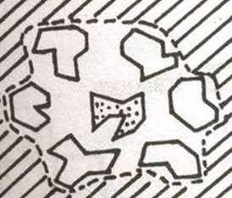
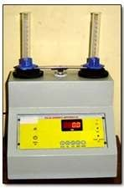
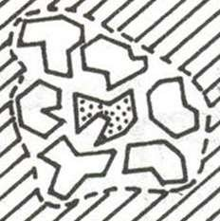
Bulk Density Apparatus
Bulk density
= Mass of the powder Bulk volume
Tapped bulk density
= Mass of the powder Tapped Bulk volume
54

Slide 55
Applications
Decides the size of the capsule based on bulk and tapped volume of a given sample
 Higher the bulk volume, lower the bulk density and bigger the size of the capsule
Helps to decide proper size of a container or packing material
55

Slide 56
 Light powders
When particles packed loosely
Lots of gaps between particles
Bulk volume increases
 Light powders have high bulk volume
 hence low density
56

Slide 57
DENSITY
True density: Volume occupied by voids (inter-
particle spaces) and intraparticle pores are not included in this measurement.
Calculated by suspending drug in solvents of various densities & in which the compound is insoluble.
After vigorous agitation, samples are centrifuged briefly, and then left to stand undisturbed till settling/ flotation has reached equilibrium. The sample that remains suspended corresponds to the true density of the material. Calculated with a pycnometer.
57

Slide 58
TRUE DENSITY DETERMINATION
Helium displacement method (for porous
powders)
Liquid displacement method (for non porous powders)
58

Slide 59
TRUE DENSITY DETERMINATION
Liquid displacement method (for non porous powders)
  Select the solvent in which powder is insoluble
  Pycnometer or sp. gravity bottle is used.
  Wt. of pycnometer: w1
  Wt. of pycnometer + sample: w2
  Sample wt.: w3= w2-w1
  Wt. of pycnometer + sample + solvent: w4
  Wt. of liquid displaced by sample: w5 = w4-w2
  Thus, true density = w3/ w5
59

Slide 60
Helium displacement Method
Helium gas is selected as it does not adsorb on solid sample.
It enters the pores.
very useful for estimating the true density of porous solids
60

Slide 61
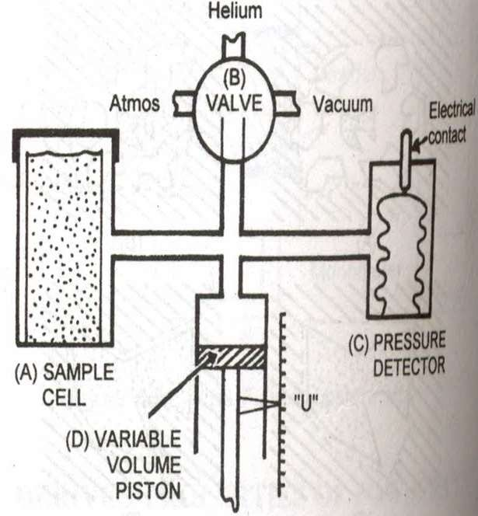
 Helium Pycnometer
Sample holder (A)
 Valve (B)
Pressure detector (C)
Piston (D)
61

Slide 62
Sample holder
 Sealed after placing the sample
Valve
  Connected to sample holder
  Has provisions for removing air from the sample holder and introducing helium gas
Pressure detector
  Maintains preset constant pressure
Piston
  Reads the corresponding pressure
  It is also related to the volume of the
62
powder

Slide 63
Working:
Air in the sample holder removed by vacuum
Helium gas introduced through valve
Pressure adjusted and set at particular value with the help of piston
At this position, the reading on the scale denotes U₁
U₁ = volume of empty sample holder
63

Slide 64
 Place standard known true volume V_{std} of stainless steel spheres
Air removed and helium gas introduced through valve
Pressure adjusted to preset value with the help of piston
At this position, the reading on the scale denotes U₂
The difference between U₁ and U₂ gives the volume occupied by the standard.
The last step involves determination of volume of sample. The standard is replaced with sample and the reading is noted, Us.
64
The difference between U and Us gives the

Slide 65
V_{std} = True volume of std. sample
V_{test} = true volume of the test sample
U₁ - U₂ = Volume occupied by the std. sample
U₁ - U_{s} = Volume occupied by the test sample
^{V}test ^{= V}std
U₁ - U₂
. (U₁ - Us )
65

Slide 66
Powder flow properties
P’ceutical powders may be broadly classified as free-flowing or cohesive.
Most flow properties are significantly affected by changes in particle size, density, electrostatic charges, adsorbed moisture.
Good flow property is required for easy and uniform flow from hopper to die cavity ensuring accurate weight and dose.
66

Slide 67
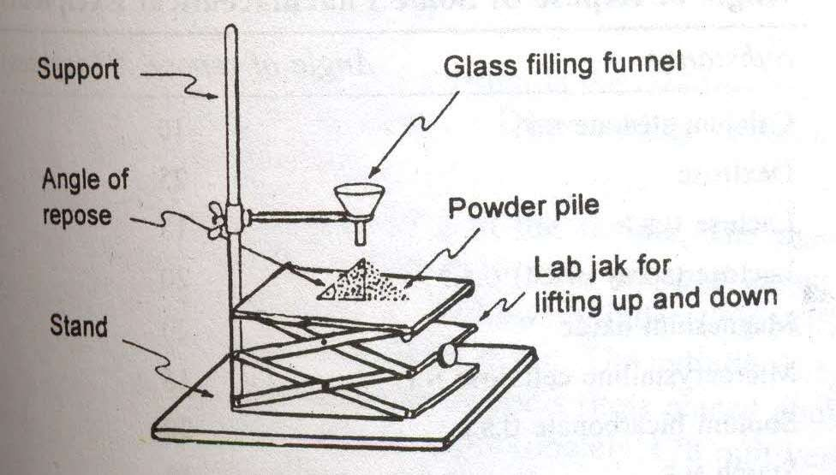
Angle of repose is calculated for estimating flow
properties.
It is defined as the maximum angle possible between the surface of a pile of the powder and the horizontal plane
67

Slide 68
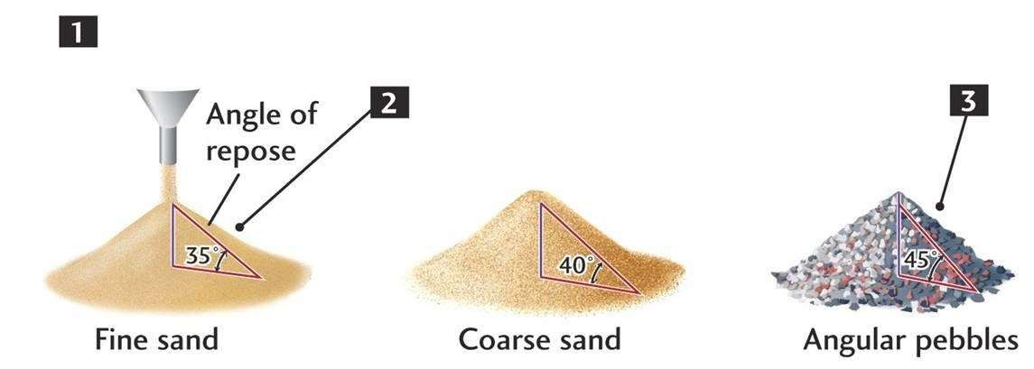
68

Slide 69
Powder flow properties estimation
Simple flow rate apparatus consisting of a metal tube from which drug flows through an orifice onto an electronic balance, which is connected to a recorder.
Angle of repose determination using reposograph
Another method is % compressibility (Carr’s index)
= (bulk volume- tapped volume) x 100 bulk volume
Hausner’s ratio
= tapped density/ Bulk density Or
Bulk volume/ tapped volume
69

Slide 70
Compres sibility Index (%)
Angle of Repose (degrees)
Flow Characte r
Hausner
Ratio
Flow Property
Excellent
25–30
10
Excellent
1.00–1.11
Good
31–35
11–15
Good
1.12–
1.18
16–20
Fair
1.19–
1.25
Fair—aid not needed
36–40
21–25
Passable
1.26–
1.34
Passable—may hang up
41–45
26–31
Poor
1.35–
1.45
Poor—must agitate, vibrate
46–55
32–37
Very poor
1.46–
1.59
Very poor
56–65
>38 Very, very poor
>1.60
Very, very poor
>66
70

Slide 71
Packing properties (Porosity)
Porosity definition: It is the ratio of the volume of voids between particles, plus the volume of pores, to the total volume occupied by
the powder, including voids and pores.
A set of particles can be filled into a volume of space in different ways.
This is because by slight vibration, particles can be mobilized and can occupy a different spatial volume than before.
This changes the bulk volume because of rearrangement of the packing geometry of the particles.
In general, such geometric rearrange⁷m¹ ents result in a

Slide 72
Packing properties (Porosity)
Example: : A set of monosized spherical particles can be arranged in many different geometric configurations.
In Fig.a, when the spheres form a cubic arrangement, the particles are most loosely packed and have a porosity of 48%
In Fig.b, when the spheres form a rhombohedral arrangement, they are most densely packed and have a porosity of only 26%
The porosity used to characterize packing geometry is linked to the bulk density of the powder.
 .
72

Slide 73
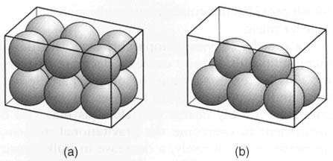
73

Slide 74
Packing properties (Porosity)
Thus bulk density, is a characteristic of a powder rather than individual particles and can be variable.
The bulk density of a powder is always less than the true density of its component particles because the powder contains interparticle voids.
Thus, powder can possess a single true density but can have many different bulk densities, depending on the way in which the particles are packed and the bed porosity.
74

Slide 75
Powder fluidization
Fluidization can be a highly effective method for handling a fine bulk material in an aerated or liquid- like condition. Air or another gas can be used for powder fluidization either in a fully fluidized state or only in a localized manner with small amounts of gas flow.
Typical bulk solids suitable for fluidization have a fine particle size, a low permeability, and low cohesive strength.
Advantages:
Elimination or reduction of poor flow problems of powder, Increased discharge rate from hopper
 Reduction in mixture segregation
75

Slide 76
Large Scale Equipment
76

Slide 77
I. Particle-size reduction
The need of size reduction can be to improve solubility thus improve its bioavialability. In case of disperse systems, it helps in improving stability (discussed earlier).
The function of size reduction may also be to aid efficient processing of solid particles by facilitating better powder mixing.
There are also some special functions of size reduction, such as reducing the bulk volume of a material to improve transportation efficiency.
77

Slide 78
Size Reduction methods
Cutting method: Cutter mill
Compression method: Endrunner and edge runner mill
Impact method: Hammer mill, vibration mill
Attrition method: Roller mill
Combined impact and attrition: ball mill,
Fluid energy mill
78

Slide 79
Size Reduction methods
1. Cutting method- Cutter mill
A cutter mill consists of a series of rotating knives attached to a horizontal rotor which act against a series of stationary knives attached to the mill casing.
During milling, size reduction occurs by fracture of particles between the two sets of knives, which have a clearance of a few millimetres.
A screen is fitted in the base of the mill casing
and acts to retain material in the mill until a
79
sufficient degree of size reduction has been

Slide 80
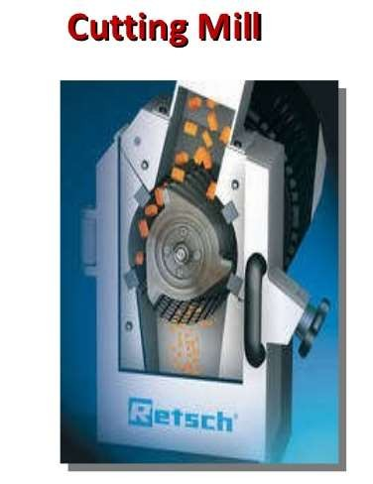
The high shear rates
present in cutter mills are useful in producing
a coarse degree of size reduction of dried granulations prior to tableting.
Used for fibrous crude drugs such as roots, peels or barks prior to extraction.
80

Slide 81
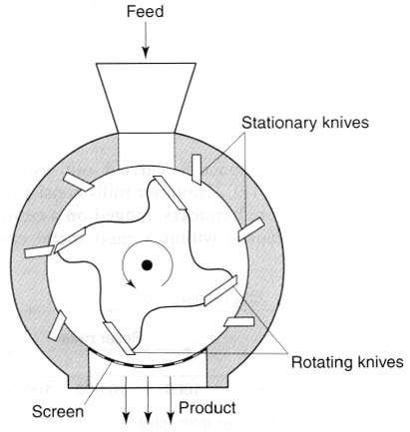
Cutter mill
81

Slide 82
II. Compression method-
Size reduction by compression can be carried out on a small scale using a mortar and pestle.
End-runner and edge-runner mills are mechanized forms of mortar and pestle.
In the end-runner mill a heavy pestle is turned by the friction of material passing beneath it as the mortar rotates under power.
The edge-runner mill has the pestles mounted horizontally. It rotates against a bed of powder, so that size reduction occurs by attrition as well as compression.
Scrapers are employed in scraping the material co₈₂nstantly from the bottom of the vessel. Such techniques are now rarely used in pharmaceutical

Slide 83
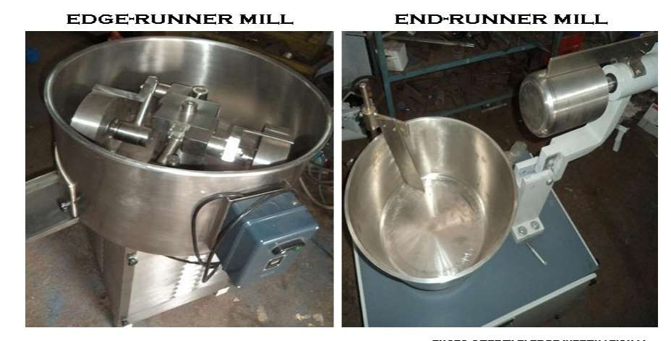
83

Slide 84
III. Impact method
Size reduction by impact is carried out using a
hammer mill.
Hammer mills consist of a series of four or more hammers, hinged on a central shaft which is enclosed within a rigid metal case.
During milling the hammers swing out radially from the rotating central shaft.
The velocity of the hammer is so high that most particles undergo brittle fracture.
84

Slide 85
Impact method
Hammer mills tend to produce powders with narrow size distributions.
Particles are retained within the mill by a screen, which allows only adequately comminuted particles to pass through.
According to the purpose of the operation, the hammers may be square-faced, tapered to a cutting edge or have a stepped form.
85

Slide 86
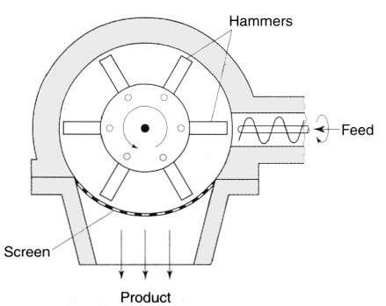
Hammer mill
86

Slide 87
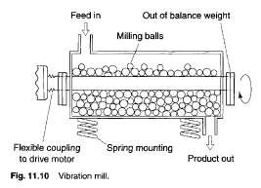
Vibration mill
Vibration mills are filled with porcelain or steel balls.
During milling the whole body of the mill is vibrated
Size reduction occurs by repeated
87
impaction.

Slide 88
IV. Attrition method
Roller mills use the principle of attrition to produce size reduction of solids in suspensions, pastes or ointments.
Two or three porcelain or metal rolls are mounted horizontally with an adjustable gap, which can be as small as 20 µm.
The rollers rotate at different speeds in counter-clockwise manner so that the material is sheared as it passes through the gap and is transferred from the slower to the faster roll,
from which it is removed by means of a s⁸c⁸ raper.

Slide 89
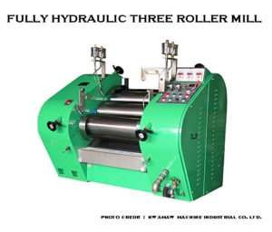
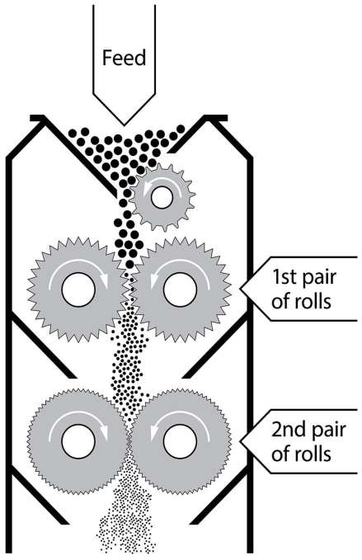
89

Slide 90
V. Combined impact and attrition methods
A ball mill is an example of a comminution method which produces size reduction by both impact and attrition of particles.
Ball mills consist of a hollow cylinder mounted such that it can be rotated on its horizontal longitudinal axis.
Mills usually contain balls with many different diameters owing to self-attrition, and this helps to improve the product as the large balls tend to break down the coarse feed materials and the smaller balls help to form the fine product by re90ducing void spaces between balls.

Slide 91
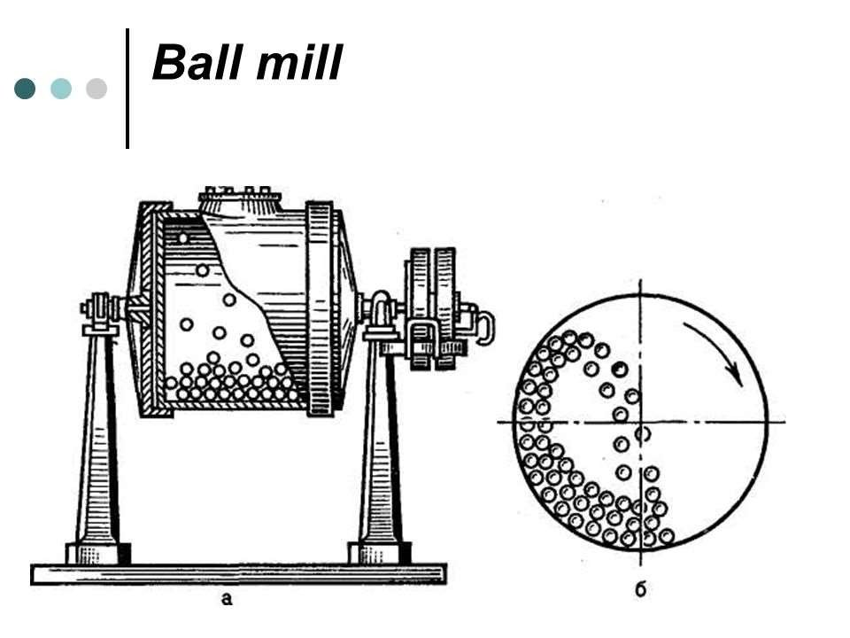
91

Slide 92
V. Combined impact and attrition methods
The amount of material in a mill is of considerable importance: too much feed produces a cushioning effect and too little causes loss of efficiency and abrasive wear of the mill parts.
The factor of greatest importance in the operation of the ball mill is the speed of rotation.
At low velocities- balls move with drum and very little relative movement of balls is
a₉c₂ hieved so the size reduction is minimal.

Slide 93
V. Combined impact and attrition methods
At high angular velocities the balls are thrown out on to the mill wall by centrifugal force and no size reduction occurs.
At about two-thirds of the critical angular velocity where centrifuging occurs, a cascading action is produced.
By this means, the maximum size reduction occurs by impact of the particles with the balls and by attrition.
93

Slide 94
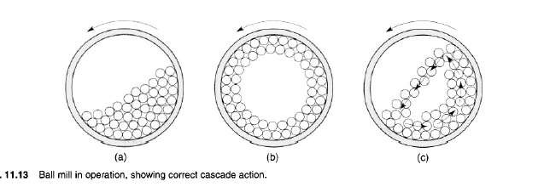
low velocity
high velocity
moderate velocity
94

Slide 95
V. Combined impact and attrition methods
Fluid energy milling is another form of size- reduction method which acts by particle impaction and attrition.
This type of mill or 'micronizer‘ consists of a hollow toroid (structure with a hole; like a doughnut) which has a diameter of 20-200 mm, depending on the height of the loop, which may be up to 2 m.
A fluid, usually air, is injected as a high- pressure jet through nozzles at the bottom.
T9h5 e high velocity of the air gives rise to zones

Slide 96
V. Combined impact and attrition methods
The high kinetic energy of the air causes the particles to impact -with other particles with sufficient momentum for fracture to occur.
Turbulence ensures that the level of particle- particle collisions is high enough to produce substantial size reduction by impact and some attrition.
A particle size classifier is incorporated in the system so that particles are retained in the toroid until sufficiently fine and remain
e₉n₆ trained in the air stream that is exhausted from the mill.

Slide 97
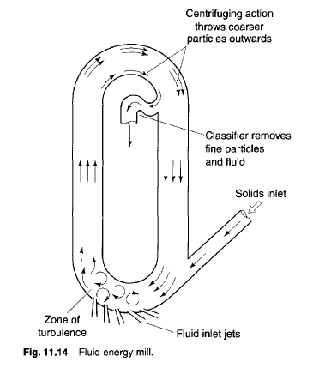

Slide 98
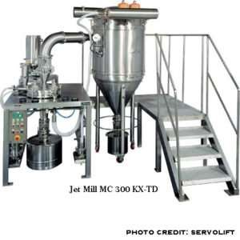

Slide 99
Particle-size separation

Slide 100
II. Particle-size separation
 Size separation is a process by which powder particles are classified into separate particle size ranges.
SIZE-SEPARATION METHODS
Size separation by sieving
Size separation by fluid classification-
  Sedimentation method
  Elutriation method
  Cyclone methods

Slide 101
1. Size separation by sieving
Principle and construction:
Same as described in size reduction
The use of sieving in size separation usually requires processing of larger volumes of powder than are commonly found in size analysis operations.
For this reason, the sieves used for size separation are often larger in area than those used for size analysis.

Slide 102
1. Size separation by sieving
 There are several techniques for separating particles into their appropriate size fractions efficiently.
1. Agitation methods- Size separation is achieved by electrically induced oscillation or mechanically induced vibration of the sieve meshes, or alternatively by gyration, in which sieves are fitted to a flexible mounting which is connected to an flywheel.
The rotation of the flywheel imparts a rotary movement of high intensity to the sieve and c₁a₀₂uses the particles to spin, thereby continuously changing their orientation and increasing their

Slide 103
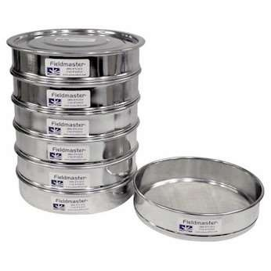
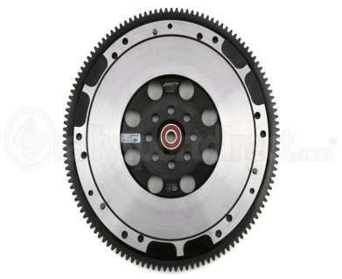

Slide 104
 Brushing methods- A brush is used to re- orientate particles on the surface of a sieve and prevent apertures becoming blocked.
1. Size separation by sieving
 A single brush can be rotated about the midpoint of a circular sieve or, for large-scale processing, a horizontal cylindrical sieve, is employed, with a spiral brush rotating about its longitudinal axis.

Slide 105
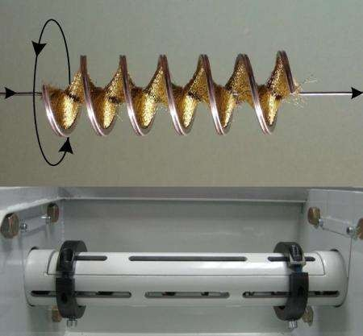

Slide 106
 Centrifugal methods - Particles are thrown outwards on to a vertical cylindrical sieve under the action of a high-speed rotor inside the cylinder.
1. Size separation by sieving
 The current of air created by the rotor movement also assists in sieving, especially where very fine powders are being processed.

Slide 107
II. Size separation by fluid classification
1. Sedimentation method
Size separation by sedimentation utilizes the differences in settling velocities of particles with different diameters, and these can be related according to Stokes‘ equations
eg. use of Andreasen pipette:
Disadvantages of this method is that they it is a batch processes and discrete particle fractions cannot be collected, as samples do not contain specific size ranges.

Slide 108
1. Sedimentation method
An alternative technique is to use a continuous settling chamber so that particles in suspension enter a shallow container, in a streamline flow.
Particles entering at the top of the chamber are acted upon by a driving force which can be divided into two components:
A horizontal component equal to the suspension fluid velocity, and a
A vertical component which corresponds to
Stokes' settling velocity and is different for e¹a⁰⁸ch particle size

Slide 109
1. Sedimentation method
The coarsest particles will have the steepest settling paths and will sediment closest to the inlet, whereas the finest particles with low Stokes velocity component will have the shallowest settling paths and will sediment furthest from the fluid suspension feed stream
Particles separated into the different hopper-type discharge points can be re¹⁰⁹moved continuously.

Slide 110
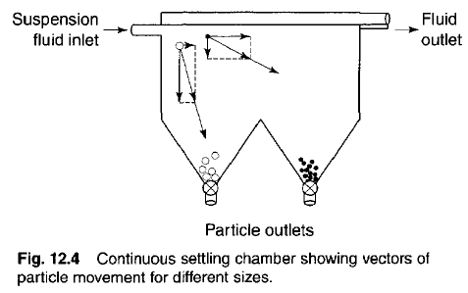
110

Slide 111
II. Elutriation method
Principle:
In sedimentation methods the fluid is stationary and the separation of particles of various sizes depends solely on particle velocity.
Therefore, the division of particles into size fractions depends on the time of sedimentation.
Elutriation is a technique in which the fluid flows in an opposite direction to the sedimentation movement, so that in gravitational elutriators particles move ve¹¹r¹tically downwards while the fluid travels

Slide 112
II. Elutriation method
Principle:
If the upward velocity of the fluid is less than the settling velocity of the particle, sedimentation occurs and the particle moves downwards against the flow of fluid.
Conversely, if the settling velocity of the particle is less than the upward fluid velocity, the particle moves upwards with the fluid flow.
Therefore, in the case of elutriation, particles are divided into different size
fractions depending on the velocity of the
112
fluid.

Slide 113
II. Elutriation method
Air may be used as the counter-flow fluid in place of water for elutriation of soluble particles into different size ranges.
There are several types of air elutriator, which differ according to the airflow patterns used.
Particles are held on a supporting mesh through which air is drawn.
The desired particle size fraction can be separated by selecting the appropriate airflow rate and rotor speed.
113

Slide 114
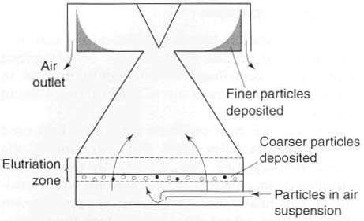
AIR ELUTRIATOR
114

Slide 115
III. Cyclone methods
Cyclone separation can take the form of a centrifugal elutriation process or a centrifugal sedimentation process in which particles sediment out of a helical gas or liquid stream.
The most common type of cyclone used to separate particles from fluid streams is the reverse-flow cyclone.
In this system, particles in air or liquid suspension are often introduced tangentially into the cylindrical upper section of the cyclone,
wh11e5
re the relatively high fluid velocity produces

Slide 116
II. Cyclone methods
Coarser particles separate from the fluid stream and fall out of the cyclone through the particle outlet, whereas finer particles remain entrained in the fluid stream and leave the cyclone through the vortex finder.
A series of cyclones having different flow rates or different dimensions could be used to separate a powder into different particle-size ranges.

Slide 117
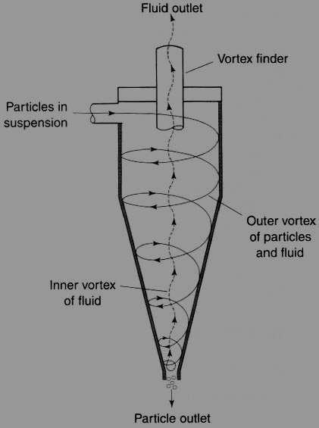
Reverse-flow cyclone separator

Slide 118
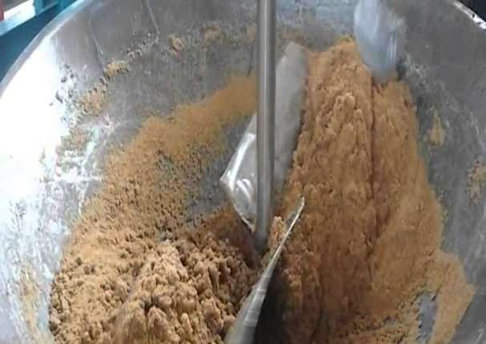
III. Powder Mixing and Demixing

Slide 119
Powder Mixing
The importance of mixing
Pharmaceutical products contain several ingredients to formulate required dosage form eg. Tablets contain variety of excipients like- diluents, binders, disintegrants and lubricants
Whenever a product contains more than one component a mixing or blending stage is required to ensure an even distribution of the active component for uniform drug distribution and release at a desired rate, for even appearance, etc

Slide 120
Mixing
Pharmaceutical mixing may be defined as a unit operation that aims to bring each component as near as possible to each unit of the other components.
If this is achieved it produces a theoretical 'ideal‘ situation, i.e. a perfect mix.

Slide 121
Powder segregation (demixing)
Segregation is the opposite effect to mixing, i.e. components tend to separate out.
Care must be taken to avoid segregation during handling after powders have been mixed, e.g. during transfer to filling machines, or in the hopper of a tablet/capsule/sachet-filling machine.
Segregation will cause an increase in content variation , weight variation in samples causing a batch to fail a uniformity of content test.

Slide 122
Reasons for Powder segregation (demixing)
Segregation arises because powder mixtures are not composed of mono-sized spherical particles, but contain particles that differ in size, shape and density.
These variations mean that particles will tend to behave differently when forced to move and hence, tend to separate.
Segregation is more likely to occur, if the powder bed is subjected to vibration.
Reasons are – particle size effects, density effects, shape effects..

Slide 123
Particle-size effects
A difference in the particle sizes of components of a formulation is the main cause of segregation in powder mixes in practice.
Smaller particles tend to fall through the voids between larger ones and so move to the bottom of the mass.
This is known as percolation segregation. eg in cereal packets or jars of coffee, where the smaller 'particles' settle towards the bottom of the container

Slide 124
Particle-size effects
During mixing, larger particles will tend to have greater kinetic energy imparted to them (owing to their larger mass) and therefore move greater distances than smaller particles before they come to rest.
This may result in the separation of particles of different size, an effect referred to as trajectory segregation.

Slide 125
Particle-size effects
During mixing, or when a material is discharged from a container, very small particles ('dust') tends to be 'blown' upwards by turbulent air currents, and remains suspended in the air.
When the mixer is stopped or material discharge is complete, these particles will sediment and subsequently form a layer on top of the coarser particles.
This is called elutriation segregation and is also referred to as 'dusting out'.

Slide 126
Particle-density effects
If components are of different density, the more dense material will have a tendency to move downwards even if the particle sizes are similar.
Particle-shape effects
Spherical particles exhibit the greatest flowability and are therefore more easily mixed, but they also segregate more easily than non- spherical particles.
Irregularly or needle-shaped particles may become interlocked, reducing the tendency to se1g26 regate once mixing has occurred.

Slide 127
Approaches to reduce/ prevent segregation
Selection of particular size fractions (e.g. by sieving to remove fines or lumps) to achieve drug and excipients of the same narrow particle size range;
Size reduction (Milling of components) to reduce the particle size (excessive size reduction should be avoided)
Controlled crystallization during production of the drug/excipients to give components of a particular crystal shape or size range.

Slide 128
Selection of excipients which have a density similar to the active component (s)
Granulation of the powder mixture (size enlargement) so that large numbers of different particles are evenly distributed in each granule.
Reduce the extent to which the powder mass is subjected to vibration or movement after mixing;
Use equipment where several operations can be carried out without transferring the mix, e.g. a fluidized-bed drier or a high-speed mixer

Slide 129
1. Tumbling mixers/blenders
Powder mixing equipment
High-speed mixer-granulators
Fluidized-bed mixers
Agitator mixers

Slide 130
1. Tumbling mixers/blenders
Tumbling mixers are commonly used for the mixing/blending of granules or free-flowing powders.
There are many different designs of tumbling mixer, e.g. double-cone mixers, twin-shell mixers, cube mixers, Y-cone mixers and drum mixers etc (see diagram)
Mixing containers are generally mounted so that they can be rotated about an axis.
When operated at the correct speed, the desired tumbling action is achieved.

Slide 131
1. Tumbling mixers/blenders
 Too high a rotation speed will cause the material
to be held on the mixer walls by centrifugal force, and too low a speed will generate little shear mixing.
The addition of 'prongs', baffles or rotating bars also helps in good mixing.
Tumbling mixers are available from approx 50 g,
e.g. for laboratory-scale development work, to over 100 kg at a production scale.
The rate of mixing depends on mixer design.
The material typically occupies about a half to
_{2/}1₃31_{rd}
of the mixer volume.

Slide 132
1. Tumbling mixers/blenders
Tumbling mixers are good for free-flowing powders/granules but poor for cohesive/poorly flowing powders.
A common use of tumbling mixers is in the blending of lubricants, glidants or external disintegrants with granules prior to tableting.

Slide 133
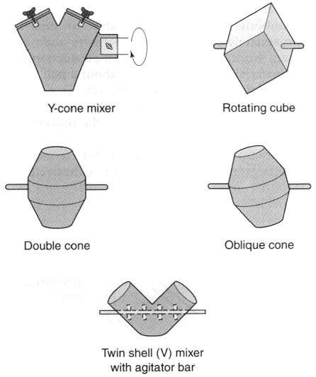

Slide 134
2. High-speed mixer-granulators
In pharmaceutical product manufacture it is often preferable to use one piece of equipment to carry out more than one function.
An example of this is the use of a rapid mixer- granulator (RMG)
As the name suggests, it can both mix and granulate a product, thereby removing the need to transfer the product between pieces of equipment and so reducing the opportunity for segregation to occur.
The centrally mounted impeller blade at the bottom of the mixer rotates at high speed, throwing the
134
material towards the wall by centrifugal force.

Slide 135
2. High-speed mixer-granulators
The particulate movement within the bowl tends to mix the components quickly owing to high shear forces (arising from the high velocity)
Once mixed, granulating agent can be added and granules formed in situ using a slower impeller speed and the action of the side- mounted chopper blade.
Because of the high-speed movement care must be taken to prevent material fracture.
e.g. Diosna® mixer-granulator

Slide 136
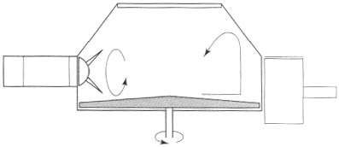
Diagrammatic representation of a high-speed mixer-granulator.

Slide 137
3. Fluidized-bed mixers
(construction and diagram: fluid energy mill)
The main use of fluidized-bed equipment is in the drying of granules or the coating of multi- particulates
Fluidized-bed equipment can, however, be used to mix powders prior to granulation in the same bowl.
Fluidization is achieved by the introduction of pressurized fluid (can be air, gas or suitable solvent) through the particulate medium.
This results in suspension of particles in fluid, wh¹³i⁷ch can be mixed, separated, or pumped

Slide 138
4. Agitator mixers
This type of mixer depends on the motion of a blade or paddle through the product, and hence the main mixing mechanism is convection.
Examples include the ribbon mixer, Nautamixer., Planetary mixer.
In the ribbon mixer, mixing is achieved by the rotation of helical blades in a hemispherical trough. (similar to screw conveyor)
The Dead spots' are difficult to eliminate in this type of mixer and the shearing action caused by the movement of the blades may be insufficient to¹³b⁸ reak up drug aggregates.

Slide 139
The ribbon mixer, however, mix poorly flowing material and is less likely to cause segregation than a tumbling mixer.
The Nautamixer consists of a conical vessel fitted at the base with a rotating screw, which is fastened to the end of a rotating arm at the upper end.
The screw conveys the material to near the top, where it cascades back into the mass.
The mixer thus combines convective mixing (as the material is raised by the helical conveyor) and shear and diffusive mixing (as the material ca¹s³⁹cades downwards).

Slide 140
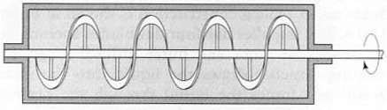
Ribbon agitator powder mixer

Slide 141
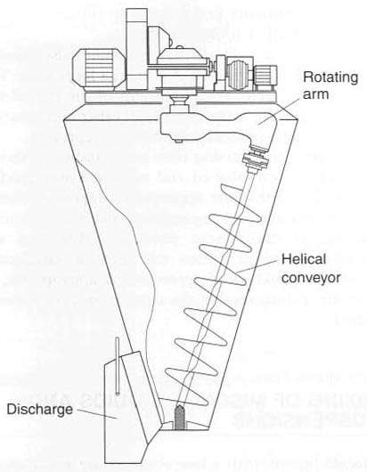
Nautamixer

Slide 142
QC of Powders
142

Slide 143
1. Particle size and shape determination
(Methods: Sieving, Sedimentation, Microscopy, light Scattering etc…)
QC of Powders (elaborate as per marks)
Surface area (BET, air permeability)
Density - Bulk density , tapped density, true density
Granule density, strength and friability
Flow properties- Angle of Repose, Compressibility Index, Hausner’s ratio
Moisture content
Percentage fines

Slide 144
QC of Powders
Granule density, strength and friability-
Granule density = Granule weight/ Granule volume
Granule volume is determined by mercury displacement method. Mercury is used as it enters voids but does not enter the pores of the particles.
Mercury also has non wetting characteristics.
Method similar to true density determination
Strength – using hardness tester
Friability: using friabilator (Roche ® friabilator)

Slide 145
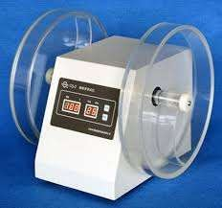
Roche ® friabilator

Slide 146
QC of Powders
MOISTURE CONTENT
The amount of moisture present in the granule is called moisture content.
Generally granules contain 2% moisture.
It is required for the binding of the powder or granules during compression in die cavity.
Percentage of moisture is calculated by using
moisture balance or IR balance.
IR balance consist of simple balance containing IR bulb which produces heat inside the chamber.

Slide 147
QC of Powders
MOISTURE CONTENT
A small amount of sample is placed in IR balance and weight is recorded (Initial reading)
IR balance is operated at specified time and temperature.
Sample is reweighed (Final reading)
Moisture content = [(Initial weight – Final weight )/ Initial weight] * 100

Slide 148
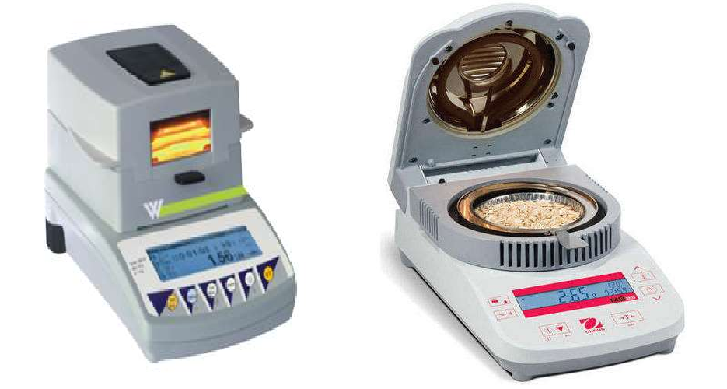

Slide 149
QC of Powders
PERCENTAGE FINES
Fines indicate particles of very minute size.
Fine powder is necessary for the tablet compression because if 100% granules are used then it is difficult to maintain hardness of tablet as they have (voids) free space in the die cavity and after compression tablet will crack due to these void spaces.
% fines can be calculated by using sieve method.

1%49
fine should not be more than 15%

Slide 150
Dusting powders,
Oral rehydration powders, Dry syrup formulations
150

Slide 151
1. Powders
Advantages
Useful for Bulky drug, large dose (e.g.
Antacids)
Swallowing easy. Tablets are difficult to swallow for children, elderly.
Faster dispersal and absorption of medicaments
Insoluble drugs which cannot be formulated as solutions can be given in powder form
Drugs which are unstable in liquid form can b15e1 given as powders

Slide 152
Disadvantages of Powders
Dose accuracy is not there in bulk powders (1 tsp, 1 tbsp need to be taken).
Difficult to carry/administer, chances of spillage while opening paper packets
Not suitable for deliquescent (tendency to absorb moisture), volatile, oxygen sensitive drugs
Time consuming to manufacture
Cannot completely mask bitter taste

Slide 153
Powders classification
For Internal use
1. Bulk
For External use (Dusting powder)
Simple
2. Divided (single dose)
Compound

Slide 154
1. Dusting powders
Dusting powders contain ingredients used for therapeutic, prophylactic or lubricant purposes and are intended for external use..
Two types:
Medical dusting powders
Surgical dusting powders
  Medical dusting powders
Used for superficial skin conditions, not on wounds, abraded/ broken skin
Thus sterility not required but it should be free fro¹⁵m⁴ pathogens.

Slide 155
Some mineral ingredients like kaolin, talc may be contaminated with spores of tetanus, gangrene, anthrax and should be sterilized before use.
e.g. Zinc undecenoate dusting powder BPC (contains light kaolin, starch, zinc undecenoate… It is antifungal preparation)
 Surgical dusting powders
Used in body cavities, wounds, burns, umbilical cord of infants. Thus it should be sterile.
Contains antibacterial agent
Diluent used may be sterilisable maize starch
e.g. Chlorhexidine and hexachlorophene dusting
¹⁵p⁵ owder

Slide 156
Dusting powders are normally dispensed in glass or metal containers with a perforated lid.
The powder must flow well from such a container, so that they can be dusted over the affected area. The active ingredients must therefore be diluted with materials having reasonably good flow properties, e.g. purified talc or maize starch.
Proprietary dusting powders are available, mostly as antifungal, antibacterial and skin disinfectants.
e15.6g. Candid Dusting powder

Slide 157
Insufflations:
It is also a type of dusting powder (for external use)
Insufflation (Latin: insufflare for "to blow into") is the act of blowing something (such as a gas, powder, or vapor) into a body cavity
It is used to produce local effect e.g. In treatment of ear, nose, throat infections or systemic effect (eg. pituitary insufflation BPC)
Diluents used are Lactose, sterilizable maize starch used
Sterility is required if preparation is for open w¹⁵o⁷ unds or raw surfaces

Slide 158
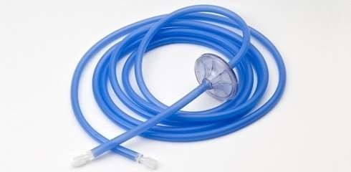
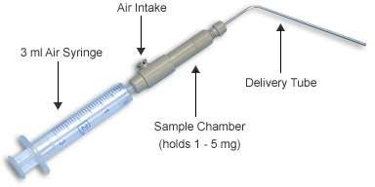
Used with an insufflator.
Insufflator blockage can be a problem because of clumping of particles thus should be stored in dry place
lack of uniform dosage is also a drawback.
158

Slide 159
ORAL REHYDRATION SALTS
Also knows as Oral rehydration powders/ therapy (ORS/ORT) is a type of fluid replacement used to prevent and
treat dehydration, especially that due to diarrhea
It involves drinking water with modest amounts of sugar and salts specifically sodium and potassium.
Oral rehydration therapy can also be given by a nasogastric tube in severe, bedridden
p¹⁵a⁹ tients.

Slide 160
ORAL REHYDRATION SALTS
In diarrhea, sodium-rich intestinal secretions are lost before they can be reabsorbed.
This can lead to life
threatening dehydration or electrolyte imbalances within hours when fluid loss is severe.
The objective of therapy is the replenishment of sodium and water lo¹⁶⁰sses by ORT or intravenous infusion.

Slide 161
ORAL REHYDRATION SALTS
Oral Rehydration Salts are dry, homogeneously mixed powders containing Dextrose, Sodium Chloride, Potassium Chloride and either Sodium Bicarbonate or Sodium Citrate for use in oral rehydration therapy after being dissolved in the requisite amount of water.
They may contain suitable flavouring agents and, where necessary, suitable flow promoting agents in the minimum quantity required to
a16c1 hieve a satisfactory product.

Slide 162
ORAL REHYDRATION SALTS
They should not contain artificial sweetening agents like mono/ polysaccharides.
If saccharin/saccharin sodium or aspartame is used in preparations meant for paediatric use, the concentration of saccharin should be such that its daily intake is not more than 5 mg/kg of body weight and that of aspartame should be such that its daily intake is not more than 40 mg/kg of body weight.
Refer Journal for formula and role of in¹⁶²gredients

Slide 163



Slide 164
Dry syrup formulations
For patients who have difficulty taking capsules and tablets, e.g. young children or elderly, a liquid preparation of a drug offers a suitable alternative.
However, many drugs, e.g. antibiotics, are physically or chemically unstable when formulated as a solution or suspension.
The method used to overcome this instability problem is to manufacture the dry ingredients of the liquid preparation in a suitable container in the form of a powder or granules.

Slide 165
Dry syrup formulations
While consuming the product, stated quantity of water (given on product label) is added to reconstitute the solution or suspension.
This enables product to remain stable without degradation.
Once it is reconstituted, the preparation should be used within a few days.
Shelf-life of the reconstituted syrup depends on the stability of API (in general, it can be 1-2 weeks)
Examples are Erythroped Suspension and
165
Amoxicillin Oral Suspension.

Slide 166
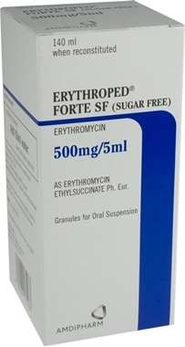

Slide 167


