Slide 1
UNIT-IV (WMC)-VI Sem Branch: IT Mobile Ad hoc Network
By
Kamlesh Chandravanshi

Slide 2
Index
Introduction
Types of Wireless Network
Characteristics of MANETs
MANET Application
Routing in MANET
Challenges of MANET Routing
References

Slide 3
Introduction
An ad-hoc network, is a network formed by nodes connected arbitrarily for some temporary time.
The proliferation of cheaper, small and more powerful devices make MANET a fastest growing network.
A Mobile Ad-hoc network (MANET) is a kind of wireless ad-hoc network having arbitrary topology (no fixed infrastructure) with mobility.
Its intrinsic Flexibility, lack of infrastructure, ease of deployment, auto-configuration, low cost and potential applications make it an essential part of future pervasive computing environments.

Slide 4
Continue
Due to nodal mobility, the network topology may change rapidly and unpredictably over time Message routing is a problem in a decentralize environment where the topology fluctuates.

Slide 5
Types of Wireless Network
These wireless networks further can be divided into following two classifications i.e.
Infrastructure based wireless network
Infrastructure less wireless network
Infrastructure Based Networks: These are the networks which work with a fixed wired/wireless backbone infrastructure and help all communication over this backbone. Infrastructure based wireless networks are also known as hosted or managed network, which consist of one or more access point being connected to an existing network.

Slide 6
Continue

Slide 7
Continue
Infrastructure less Wireless Networks: These networks work without the presence of a base station. Here, wireless devices communicate to each other through point-to-point connections.
Multi-hop data forwarding is the one important aspect in infrastructure less wireless networks. Thus, the nodes that reside in immediate radio range of each other can only communicate via direct point-to-point connections.

Slide 8
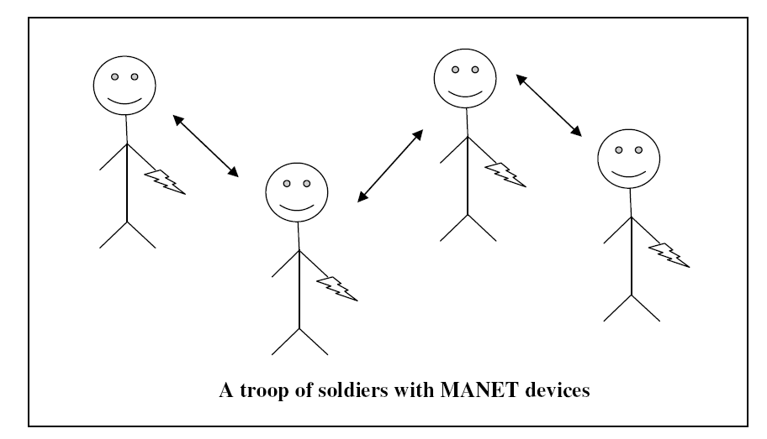
Example of Infrastructure less Wireless network

Slide 9
Difference between Infrastructure based and Infrastructure less Networks
Attribute | Infrastructure based wireless networks | Infrastructure less wireless networks
Switching | Circuit Switching | Packet Switching
Routing | Centralized Routing policies are followed in the network | Distributed routing scheme is used in these network
Bandwidth Reservation | Easy to employ due to centralized control | Difficult to employ, as all node are equally responsible in network operation and it leads to lack of operation
Application Domain | Civilian and commercial | Battle field, emergency search and rescue operations
Complexity | Mobile hosts are less complex | Mobile hosts are highly complex due to holding of various capabilities
Routing Goal | Major goal of routing is to maximize ration and minimize the call drop ratio | Major goal of routing is to find path with minimum overhead and quick reconfiguration of broken path
Link Type | Single hop | Multi hop

Slide 10
Characteristics of MANETs
A Mobile Ad-Hoc Network is a special type of wireless network, which shares common characteristics of wireless networks, these are following characteristics
Dynamic Network Topology
Decentralized Operations
Limited Energy
Multi Hop Communication
Autonomous Terminal

Slide 11
Properties of Ad-Hoc Routing protocols
Mobile ad hoc network routing acquire the following properties such as
Distributed operation
Loop free
Demand based mostly operation
Unidirectional link support
Security
Power conservation
Multiple routes
Quality of Service Support

Slide 12
Applications of MANETs
Military Battlefield
Commercial Application
Collaborative Networks
Home Networks
Emergency Services

Slide 13
Routing In MANETS
There are various ways to classify MANETs based on the characteristics of their routing protocols. Some typical ways to classify them are the following.
Proactive Routing
Reactive Routing
Hybrid Routing

Slide 14
Categorization of Ad-Hoc Routing Protocol
Ad hoc Routing Protocol
Proactive
Reactive
Hybrid/ Other
DSDV
WRP
AODV
DSR
LMR
ABR
CEDAR
CGSR
TORA
SSR
STARA
ZRP

Slide 15
Proactive Protocols (Table Driven Routing protocols)
Routing information is kept in the routing tables and is updated periodically when the network topology change.
On the other hand routes will always be available on request. Most internet standard routing protocols and some ad-hoc protocols such as DSDV (Destination Sequenced Distance Vector) and OLSR (Optimized Link-State Routing) are examples of this group.
Many of these routing protocols come from the conventional link-state routing. These routing protocols maintain different number of tables.

Slide 16
Reactive Protocols (On-Demand Routing Protocols)
These are sent out to immediately connected routers that pass on the request for a path to a given destination. If a router with contact to the destination is reached, it messages back its availability.

Slide 17
Continue
The first Route Reply received (RREP) determines the route to be used.
Reactive routing can cause overhead on a network by congested channels with route requests. The system is appropriate for constantly changing networks such as ad-hoc mobile networks.

Slide 18
Hybrid Protocols. (Combination of Reactive and Proactive protocols)
Is I combination of proactive and reactive routing such as
Zone Routing Protocol (ZRP)
Geographic Addressing and Routing (Geo Cast )
Distance Routing result rule for Mobility (DREAM )
Greedy Perimeter unsettled Routing (GPSR )

Slide 19
Challenges of Mobile Ad Hoc Networks
Mobility of Nodes: In this type of network, nodes may or may not be mobile. Thus, it is difficult to design topology of network.
Dynamic Topology: Direct links between nodes can be broken and renewed rapidly due to mobility. Topology of these networks changes very frequently as compared to the wired network, where topology change is generally due to occasional link failure or link re-establishment.
Size of the Network: The size of the network is not fixed due to the Ad hoc Nature of network. At one end, old nodes can leave the network; on the other side new nodes can join the network.

Slide 20
Continue
No Centralized Control: Participant nodes in Ad hoc networks can change dynamically and can join or leave the network independently. Due to this nature of ad hoc networks it is difficult to provide centralized control.
Bandwidth: All nodes share a common channel, thus, only a fraction of bandwidth is available for every node. Hence effective requirement is more.
Residual Battery Power: The remaining battery power of a node plays a major role in enhancing the lifetime of a network. Thus, maintaining residual power of a node is also a big challenge.

Slide 21
Problems With Routing In MANETs
Asymmetric Links: In ad-hoc networks, as the nodes are mobile and keep changing their location in the network, so it does not rely on symmetric links as in the case of wired network.
Dynamic Topology: Nodes in the network are free to move; hence network topology may change unpredictably and randomly over time.
Routing Overhead: In ad-hoc network nodes may change their position in the network. So, there is a possibility that some stale routes are generated in the routing table which leads to unnecessary routing overhead.

Slide 22
Continue
Inference: As links come and do depending on the transmission characteristics, one transmission might get collide with other and node may overhear the transmission of other and can corrupt the whole transmission.
Limited Power Supply and Radio Range: Wireless links have lower capacity than wired networks. Due to limited power supply MANETs have limited radio range.
Energy Consumption: Nodes in the mobile ad-hoc networks heavily depends on battery life for their energy. To maximize the lifetime of network energy conservation is the key challenge of MANET.

Slide 23
Continue
Mobility-induced Route Changes: As nodes in the ad-hoc networks are mobile; hence on-going session suffers link failure. This often leads to route changes.
Security: MANET is prone to eavesdropping and security attacks than infrastructure networks because of its infrastructure less nature.

Slide 24
Reference
[1] Stuedi, Patrick “Quality of service for mobile ad hoc networks” ETH Library, 2003
[2] Alberto López, Jukka Manner, Andrej Mihailovic, Hector Velayos, Eleanor Hepworth, and Youssef Khouaja. A study on qos provision for ip-based radio access networks, 1999. IST project IST-1999-10050 BRAIN.
[3] Jukka Manner, Alberto Lopez, Andrej Mihailovic, Hector Velayos, Eleanor Hepworth, and Youssef Khouaja. Evaluation of mobility and qos interaction.

Slide 25
Thank You

