Slide 1
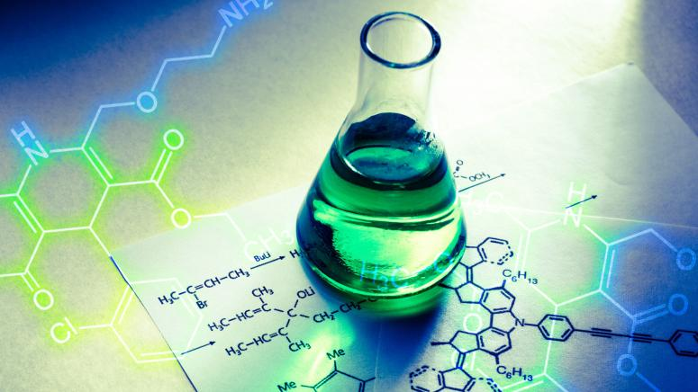
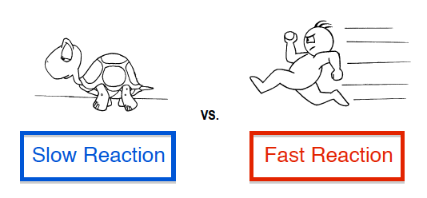
Kinetics & Drug Stability
Presented by
Mrs. Rama Shukla
Asst. Prof.
LNCP, Bhopal

Slide 5
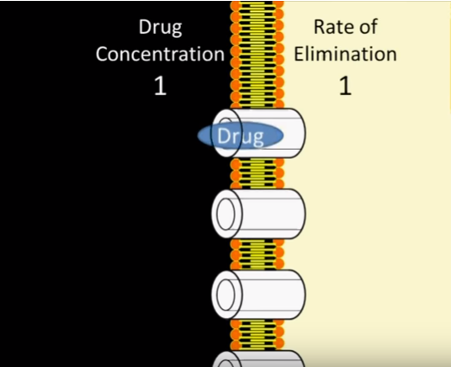

Slide 6
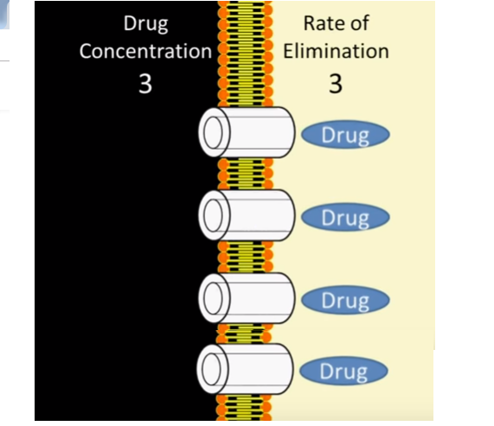

Slide 7
FIRST ORDER KINETICS
In First order kinetics , Active enzymes are waiting to work.
Increase in Plasma drug concentration Increase rate of drug metabolism (elimination).
Rate of metabolism is directly proportional to drug concentration.
It applies to absorption and metabolism too.

Slide 8
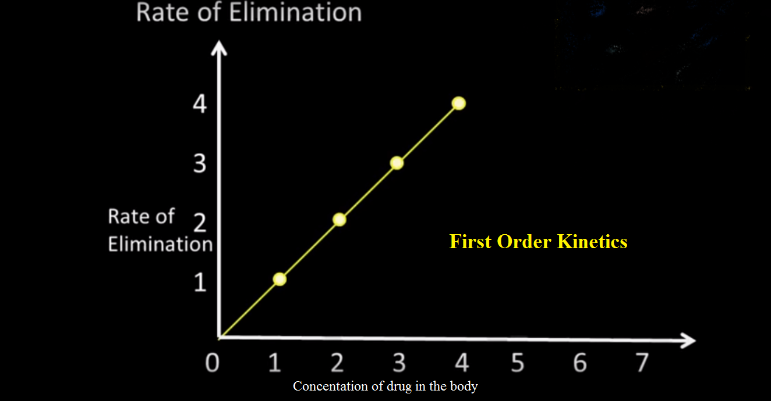

Slide 9
Zero order kinetics
Low action enzymes working to sustained the drug concentration.
Increase in Plasma drug concentration No Increase in rate of drug metabolism.
Rate of metabolism becomes independent of drug concentration.

Slide 10
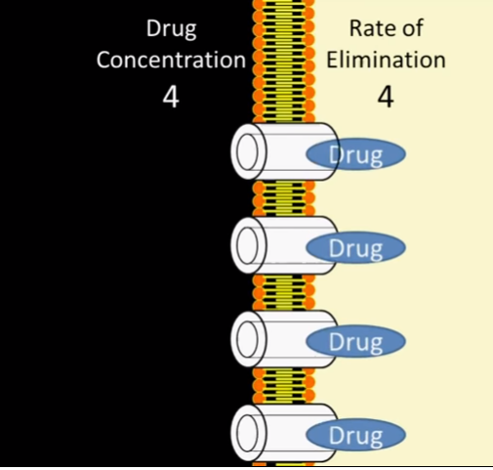
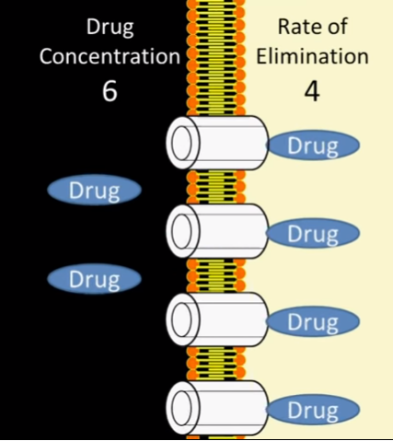
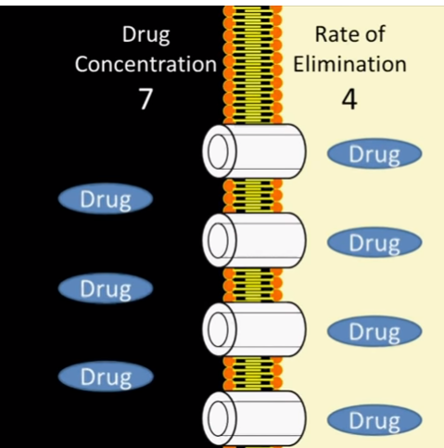
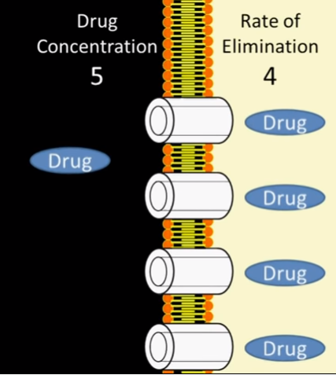

Slide 15
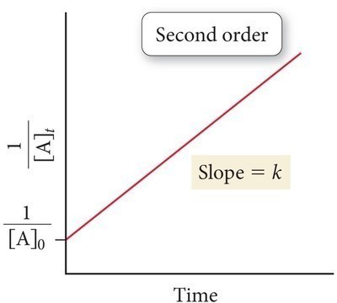

Slide 17
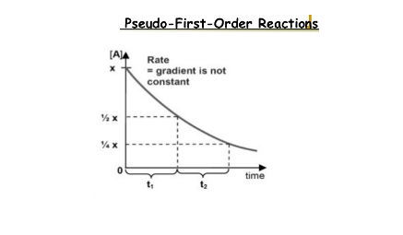
Pseudo first order
A reaction which is not first-order reaction naturally but made first order by increasing or decreasing the concentration of one or the other reactant is known as Pseudo first order reaction. Pseudo means ‘fake’.
Therefore, it is clear from the name itself that it is not first-order reaction by nature. Example: suspension

Slide 18
Pseudo first-order
Another example of pseudo first-order reaction is the inversion of cane sugar.
C₁₂H₂₂O₁₁ + H₂O → C₆H₁₂O₆ + C₆H₁₂O₆
Cane sugar Glucose Fructose

Slide 19
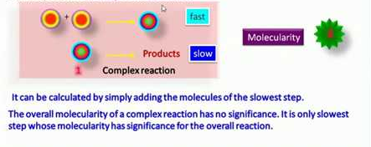
COMPLEX REACTIONS
Many chemical reactions encountered in the pharmaceutical field are not simple reaction of Zero, first, second and third order but consists of a Combination of two or more reactions. such reactions or known as “Complex reactions”.
K K1
A B C
Intermediated reaction B(characterized by order of kinetics Zero, First, Second, Third step)

Slide 20
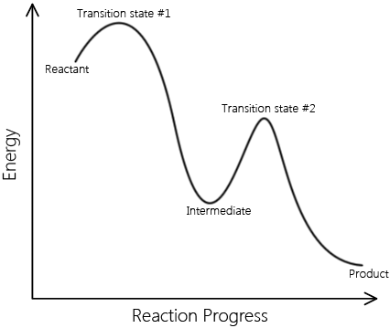
Complex reaction

Slide 22
